Slide 1
Design Thinking and Innovation
Product Name : Smart Stick
Design supervisor name :
Name of the student :
Register number :

Slide 2
Presentation outline
Introduction
Problem statement
Abstract
Components and supplies
Necessary tools and machines
Apps and online services
Steps to make the smart stick
Coding
Reference
Connections

Slide 3
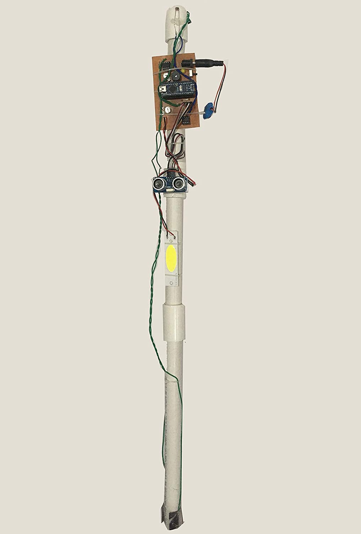
Smart stick
Presented by :
Vasundhara
Veljai
Vignesh
Vigneshwari
Vishnu
Vishwanth

Slide 4
Problem statement :
Currently there are thousands of blind people all over the globe.
These include people from low sight seeing to complete lost of visual.
They find it very difficult while crossing the road or reaching to their respective destination with the help of any other individual.
The traditional stick cannot help to detect the obstacles in front or the potholes in the way. It is outdated.
Hence there is a need to update it using today's technology.

Slide 5
ABSTRACT
In this paper we proposed a solution for the blind people by using an ultrasonic sensor in the smart stick
In this Smart stick there is a sensor which senses the obstacles or walls from 1 or half meter range then this stick vibrates & makes buzz sound..
This Smart Stick warns the blind person that there is an obstacle or wall in-front of him/her.. Then that person will be warned from obstacle or wall.

Slide 6
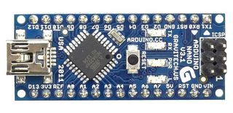
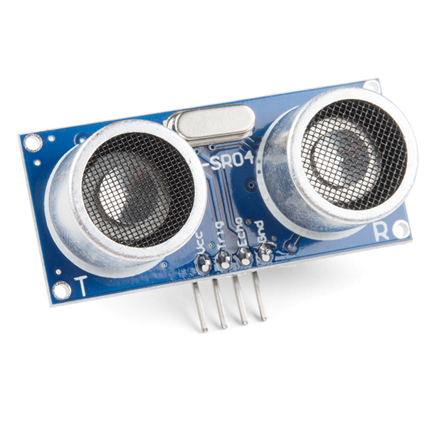
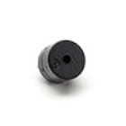
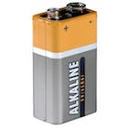
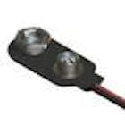
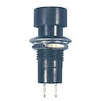
COMPONENTS AND SUPPLIES
Arduino uno × 1
Ultrasonic sensor × 1
Buzzer × 1
9v battery × 1
9v battery clip × 1
Pushbutton switch,momentry × 1

Slide 7
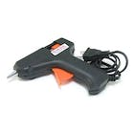
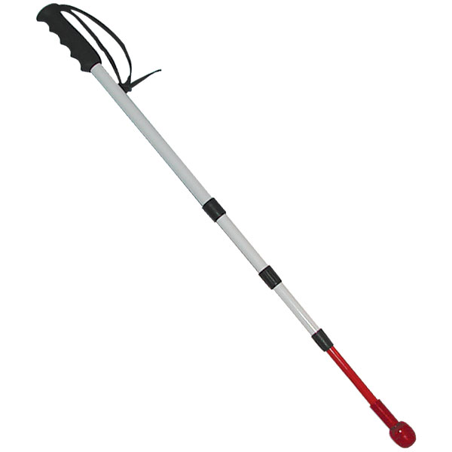

NECESSARY TOOLS AND MACHINES
Hot glue gun
Wodden stick
APPS AND ONLINE SERVICES
Arduino IDE

Slide 8
Steps to make the smart stick :
1. Take Arduino uno, Buzzer, Ultrasonic sensor, Vibrating motor, battery, switch, and a wooden stick or plastic pipe.
2. Take stick and place ultrasonic sensor on it. Connect the Jumper wires on it.
3. Then place Buzzer and Vibrating motor on the stick.
4. Connect the jumper wires to buzzer and Vibrating motor.
5. Do connections from circuit diagram.
6. Place the Arduino uno, Battery and switch on the stick.
7. Upload the code.
8. After Uploading now check for the Smart stick.

Slide 9
Coding :
const int trigPin = 3;
const int echoPin = 2;
const int buzzer = 5;
const int motorPin = 6;
long duration;
int distance;
int safetyDistance;
void ()
{ pinMode(trigPin, OUTPUT);
pinMode(echoPin, INPUT);
pinMode(buzzer, OUTPUT); pinMode(motorPin, OUTPUT);
Serial.begin(9600); }
void ()
{ digitalWrite(trigPin, LOW);
delayMicroseconds(2);
digitalWrite(trigPin, HIGH);
delayMicroseconds(10);
digitalWrite(trigPin, LOW);
duration = pulseIn(echoPin, HIGH);
distance= duration*0.034/2;
safetyDistance = distance;
if (safetyDistance <= 30){
digitalWrite(buzzer, HIGH);
digitalWrite(motorPin, HIGH);
} else
{ digitalWrite(buzzer, LOW);
digitalWrite(motorPin, LOW); }
Serial.print("Distance: ");
Serial.println(distance); }

Slide 10
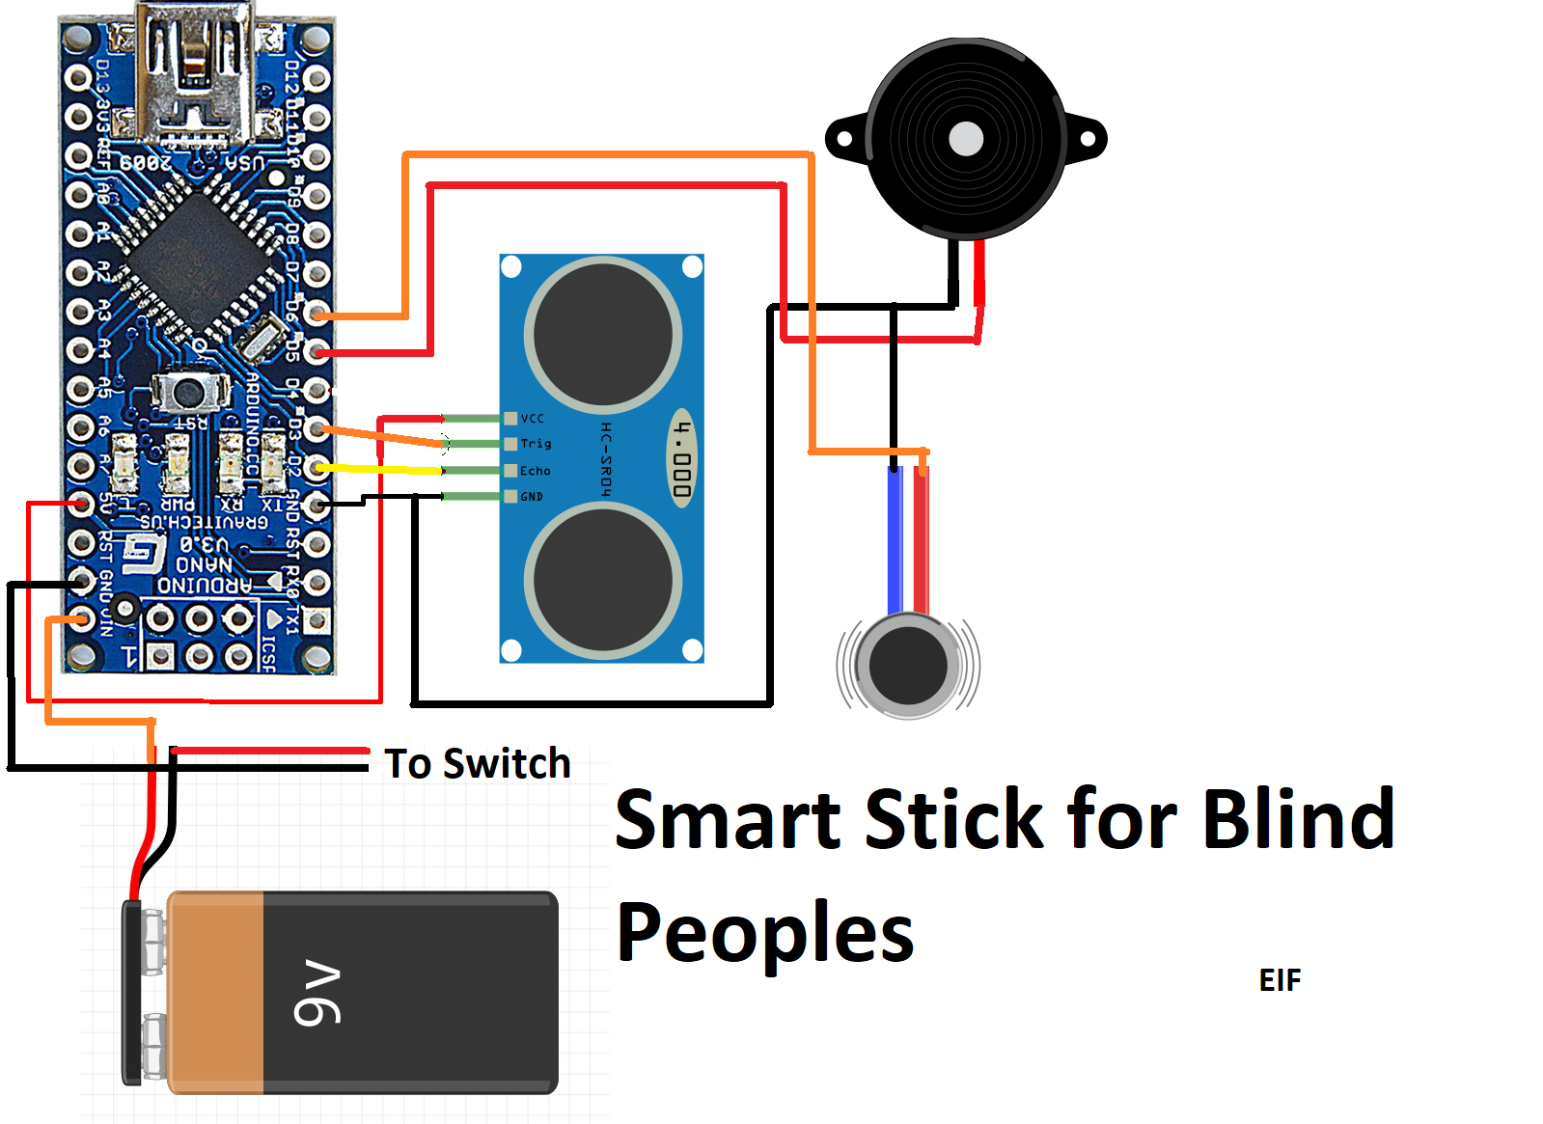
Connections :

Slide 11
REFERENCE
[1] R. Radhika, P.G. Pai, S. Rakshitha and R. Srinath “Implementation of Smart Stick for Obstacle Detection and Navigation.” International Journal of Latest Research in Engineering and Technology, vol. 2, number 5, pp. 45-50, 2016.
[2] M.H. Mahmud, R. Saha and S. Islam “Smart Walking Stick – An Electronic Approach to Assist Visually Disabled Persons.” International Journal of Scientific and Engineering Research, vol. 4, number 10, pp. 111-114, 2013.
[3] A. Jose, G. George, M.R. Nair, M. J. Shilpa and M. B. Mathai “Voice Enabled Smart Walking Stick for Visually Impaired.” International Journal of Advanced Research in Electrical, Electronics and Instrumentation Engineering, vol. 5, pp. 80-85, 2016.
[4] R. Sheth, S. Rajandekar, S. Laddha and R. Chaudhari “Smart White Cane – An Elegant and Economic Walking Aid.” American Journal of Engineering Research. Vol. 3, number 10, pp. 84-89, 2014.
[5] C.S. Kher, Y.A. Dabhade, S.K Kadam., S.D. Dhamdhere and A.V. Deshpande “An Intelligent Walking Stick for the Blind.” International Journal of Engineering Research and General Science, vol. 3, number 1, pp. 1057- 1062, 2015.

Slide 12
[6] B.G. Roopashree, B.S. Patil and B.R. Shruthi “Smart Electronic Stick for Visually Impaired.” International Journal of Innovative Research in Science, Engineering and Technology, vol. 4, number 7, pp. 6389-6395, 2015.
[7] O. O. Olakanmi, “A Multidimensional Walking Aid for Visually Impaired Using Ultrasonic Sensors Network with Voice Guidance", International Journal of Intelligent Systems and Applications (IJISA), vol. 6, number 8, pp. 53-59, 2014. DOI: 10.5815/ijisa.2014.08.06
[8] E. J. Chukwunazo and G. M. Onengiye “Design and Implementation of Microcontroller Based Mobility Aid for Visually Impaired People.” International Journal of Science and Research. Vol. 5, issue 6, pp. 680-686, 2015.
[9] G. Prasanthi and P. Tejaswitha “Sensor Assisted Stick for the Blind People.” Transactions on Engineering and Sciences, vol. 3, number 1, pp. 12-16, 2015.

Slide 13


